Slide 1
Problem statement:
9.1.Using the definition of deduction, prove the following deduction:

Slide 2


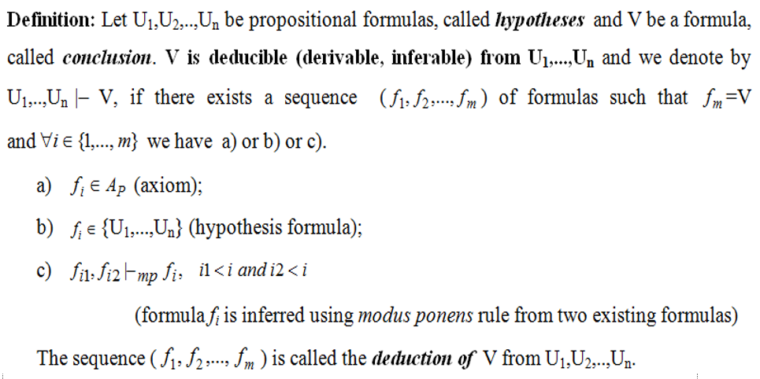
Theoretical Part

Slide 3
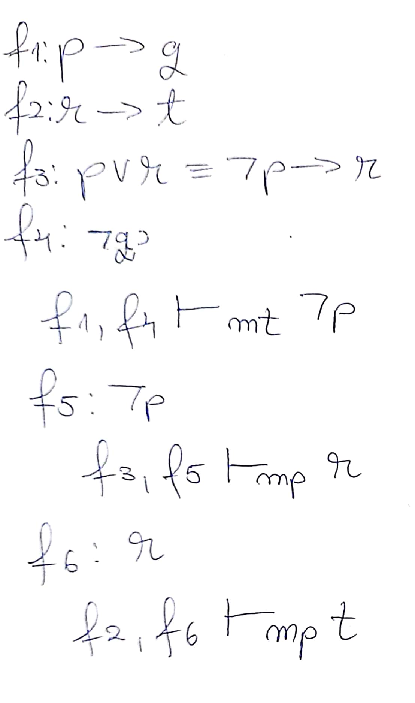
Solution
f7 = t was proved from hypotheses (f1, f2, f3, f4, f5, f6) using modus ponens and modus tollens
f7 : t

Slide 4
Bejenaru Florin Danut

